Slide 1
The Science of Psychology
Experimental Psychology

Slide 2
Science of Psychology
Features of science
Why psychology is a science
Empiricism vs. rationalism
Science vs. pseudoscience
Falsifiability
Scientific research
Basic vs. applied research
Folk psychology
Confirmation bias
Skepticism

Slide 3
Characteristics of Science
Empirical research question has to be observable
Psychology is a science
Why might some people argue that psychology is not a science?

Slide 4
Is it science?
Science—way of knowing that is based on empirical studies
…that are informed by prior research
Empirical study (Empiricism)
Research based on systematic observation
Pseudoscience—appears to be scientific, but it is not

Slide 5
Characteristics of Science: Empiricism
Empiricism
Based on systematic observation
Rationalism
Based on thought, rationality, logic
What is an example of an empirical research question? What is an example of a nonempirical research question?

Slide 6
Why We Need Science
To think critically about what we learn
To challenge our intuitions about human behavior (our folk psychology)
What are some intuitions about psychology you have or have heard?

Slide 7
Characteristics of Science: Pseudoscience vs. Science
Science must be:
Falsifiable—has to be able to be disproven
What are some non-falsifiable claims?
Pseudoscience is not falsifiable
What are some pseudoscientific claims?
Video: Fear of Science is Killing Us

Slide 8
Video Review
Skepticism
What are some other topics people may be taking for “face value?”
Confirmation bias
We tend to pick out the facts that support our theory
Have you experienced confirmation bias?

Slide 9
Basic vs. Applied Research
Basic research- designed to gain greater understanding of a phenomenon, not necessarily try to address a problem
Applied research- designed to address a problem
What are two examples of each type of question?

Slide 10
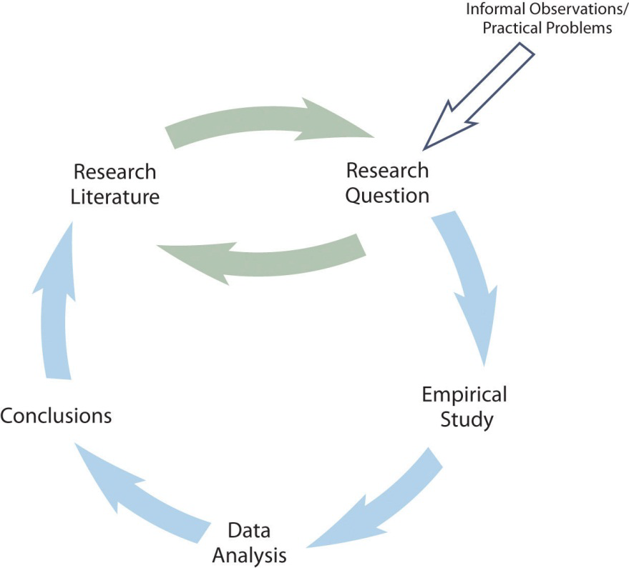
Process of Scientific Research

